Slide 1
Machine Learning–Based Carbon Emission and Energy‑Use Prediction for Sustainable Living
Tapodyuti Sarkar RA2412049015096
First Review
Guide: Dr. Pitchaimanikam
Date: 1/2/26

Slide 2
Abstract
Climate change driven by rising carbon dioxide emissions is a critical global threat, directly addressed by SDG‑13: Climate Action. Residential and small‑scale energy use accounts for a significant share of global emissions, yet individuals lack simple, data‑driven tools to understand and reduce their footprint.​
This project proposes a machine learning framework to predict household energy consumption and associated CO₂ emissions from easily measurable features such as appliance usage, fuel type, and basic building characteristics. The system compares multiple models (Linear Regression, Random Forest, Gradient Boosting, XGBoost, and a lightweight neural network) using metrics like MAE, RMSE, and R², and selects the best model to power a user‑facing web dashboard.​
The expected outcome is an interpretable prediction tool that not only estimates emissions but also provides feature‑based insights and simple what‑if scenarios (e.g., switching fuels, reducing usage) to support practical decarbonization decisions at the household level. This contributes to SDG‑13 by translating ML‑based carbon‑emission research into an accessible decision‑support application.
Notes:
Depict your overall work abstract as a diagram

Slide 3
Introduction
Climate change is driven largely by human greenhouse gas emissions, with carbon dioxide from energy use as the dominant contributor.​
Residential and commercial buildings account for a substantial share of global final energy consumption and related CO₂ emissions, directly linking this sector to SDG‑13: Climate Action.​
In many regions, especially developing countries, increasing adoption of energy‑intensive appliances and rising electricity/LPG use intensify the climate impact of households.​
Most individuals lack quantitative tools that convert their everyday energy‑use patterns into estimated emissions and clear, personalized reduction strategies, creating a gap between awareness and action.​
Recent research shows that machine learning models can accurately predict building energy demand and CO₂ emissions from features such as floor area, building type, climate zone, and usage profiles.​
However, many existing ML solutions focus on aggregate forecasts (city or national level) or act as complex black boxes, limiting their usefulness for household‑level decision making and practical climate‑action planning.​
Notes:
Depict your overall work abstract as a diagram

Slide 4
Motivation
Why This Project Matters:
Global Climate Crisis
  Climate change driven by rising CO₂ emissions threatens global sustainability
  Directly addressed by SDG-13: Climate Action
Residential Sector Gap
  Residential and small-scale energy use accounts for 30-40% of global emissions
  Yet individuals lack simple, data-driven tools to understand their carbon footprint
Awareness-Action Gap
  Most people cannot quantify how their daily energy habits translate to CO₂ emissions
  No accessible tools for personalized reduction strategies at household level
Machine Learning Opportunity
  ML models can accurately predict building energy and CO₂ from simple features
  Transform complex climate data into actionable household-level insights
SDG-13 Alignment
  Empowers individuals to make informed decisions for decarbonization
  Bridges gap between climate awareness and practical action

Slide 5
Literature Review
Title of the Paper | Journal | DataSet Used | Contributions | Limitations
An examination of daily CO₂ emissions prediction through machine learning and deep learning models (Ye et al., 2025) | Environmental Research Letters (Nature Portfolio) | Daily national CO₂ emissions for major emitting regions (2022–2023) | Evaluates 14 models (ARMA, RF, XGBoost, CNN–RNN hybrids); ensemble ML achieves R² 0.714–0.932 and is recommended as best trade‑off between accuracy and complexity. | National‑level focus only; does not address household/building‑level predictions or user‑facing tools.
Machine learning models for predicting rural residential carbon emissions and optimising spatial forms (Liu et al., 2025) | Scientific Reports (Nature) | Rural residential land-use and carbon-emission spatial features for large regions | Uses ML models to estimate emissions from spatial‑form variables and explores optimisation of rural settlement patterns for emission reduction. | Requires detailed GIS/spatial‑form data; generalisation to urban or non‑mapped areas is unclear.
Predicting residential CO₂ emissions: Machine learning and deep learning approaches (Khan et al., 2025) | Sustainability in Building and the Environment (Durabi) | Daily residential CO₂ emissions data for U.S. buildings (2022–2024). | Compares 6 ML Models (DT, RF, Ridge, GB, SVR, XGBoost and LSTM); tuned ensembles and LSTM achieve best RMSE/R², outperforming statistical baselines. | Uses a single national dataset and daily aggregates; no interactive tool or per‑household explainability.
Notes:
In a tabular format, brief 5 references, which are closely related to your work. Citations and references should be in IEEE format

Slide 6
An interpretable machine learning framework for residential building energy and carbon emissions (Chen et al., 2025) | Explainable ML framework in Scientific Reports. | Residential building energy and carbon-emission data with operational/structural features | Proposes tree‑based models plus SHAP/permutation importance to analyse how building characteristics and operation drive emissions. | Focuses on design/retrofit optimisation; requires rich feature sets and is less oriented to simple user questionnaires.
Machine learning applications for carbon emission estimation: A comprehensive survey (Smith & Rodriguez, 2025) | Cleaner Engineering and Technology (Elsevier) | Multiple published datasets across industrial, transport, building and national emissions (survey article). | Reviews ML/DL techniques (tree‑based, neural nets, hybrids) for emission estimation; summarises drivers, metrics and performance. | Survey only; doesn’t implement or evaluate a concrete end‑user tool, mainly highlights gaps like interpretability and actionable models.
Building energy consumption prediction using deep learning (Davis et al., 2024) | Applied Energy / technical report | Non-domestic building energy-consumption data (annual/sub-annual loads) | Compares MLP ANN, SVM and Decision Tree; ANN gives lowest MAE/RMSE with a clear preprocessing and evaluation pipeline. | Targets specific building types and annual energy use; CO₂ emissions and user‑facing interfaces are not considered.
Intelligent prediction method of building energy consumption based on deep learning (Wang et al., 2024) | International Journal of Photoenergy (Hindawi) | Time-series building energy data from university building, Southwest China | Proposes improved LSTM (ILSTM) with Adam optimization. Reports lower MAE/RMSE than comparison methods; demonstrates DL effectiveness for full-cycle prediction. | Single‑building case study; relies on dense sensor data and has limited external validity.
Notes:
In a tabular format, brief 5 references, which are closely related to your work. Citations and references should be in IEEE format

Slide 7
A deep learning framework for building energy consumption forecasting (Zhang et al., 2024) | Renewable & Sustainable Energy Reviews | Hourly building load and weather data for several commercial buildings | Uses CNN–LSTM hybrid for short‑term load forecasting; significantly lower MAE/RMSE than traditional LSTM and SVR. | CNN–LSTM is GPU‑intensive and requires high‑frequency data, making deployment on low‑resource systems difficult.
Research on building energy consumption prediction based on machine learning (Li et al., 2024) | Energy Reports | Building energy records with features like floor area, orientation, HVAC type | Compares Random Forest, Gradient Boosting and SVM; Random Forest gives best generalisation and shows value of feature engineering and cross‑validation. | Focuses on energy, not explicit CO₂ emissions; no interactive decision‑support interface for non‑expert users.
Forecasting CO₂ emission in the US using machine learning methods (Ahmed et al., 2023) | Journal of Data Science and Intelligent Systems | Historical U.S. CO₂ emissions and macro‑economic indicators | Uses regression, SVR, Random Forest and Gradient Boosted Trees to forecast national emissions; ensembles outperform linear models. | Works at macro (national) scale; does not connect predictions to household‑level actions or behaviour change.
Building energy prediction models and related uncertainties (White, J., & Jones, P. (2022) | Buildings (MDPI) | Overview of data‑driven and physics‑based building energy prediction models. | Discusses model uncertainty, validation practices and classification of prediction approaches. | Focuses more on uncertainty and taxonomy than on specific DL architectures or CO₂ outputs.
Energy consumption prediction by using machine learning (Shapi et al., 2021) | Energy Reports (Elsevier) | General energy‑consumption datasets modelled on Azure ML platform. | Demonstrates practical ML workflows (regression, tree‑based models) for energy prediction with cloud‑based tools. | Not building‑specific and not focused on deep learning; more a generic ML energy case study.
Notes:
In a tabular format, brief 5 references, which are closely related to your work. Citations and references should be in IEEE format

Slide 8
A state‑of‑the‑art review on the prediction of building energy consumption (Li et al., 2020) | Building Services Engineering Research & Technology. | Survey of published building energy prediction studies.​ | Summarises traditional and data‑driven methods (regression, ANN, SVM, ensembles), inputs and performance metrics. | Predates the most recent DL/transformer‑style models; limited coverage of interpretability and user‑oriented tools.
Modeling and forecasting building energy consumption: A review (Bourdeau et al., 2019) | Sustainable Cities and Society. | Survey of building‑scale energy‑consumption modelling studies | Early comprehensive review of ANN, SVM, GP and ensemble approaches for building energy forecasting; highlights data and uncertainty issues. | Focuses mainly on energy, not explicit CO₂ emissions, and covers few modern deep learning architectures.
A Machine Learning Framework for Energy Consumption in Buildings (Madhusudanan, 2019) | Master’s thesis, Clemson University. | Building‑level energy data with multiple operational features.​ | Proposes a full ML pipeline (preprocessing, model selection, evaluation) for building energy prediction. | Thesis‑level work; scope and datasets are limited compared with large multi‑country or multi‑building studies.
Evolutionary Deep Learning‑Based Energy Consumption Prediction for Buildings (Almalaq & Edwards, 2018) | IEEE Transactions / conference (energy‑informatics context). | Building energy‑consumption time‑series data. | Combines genetic algorithm with LSTM to optimise architecture and hyperparameters for building energy prediction, showing DL can outperform conventional models. | Early DL implementation; relatively small datasets and little focus on interpretability or deployment constraints.
Application of Deep Learning Model in Building Energy Consumption Prediction(Rahman & Ali, 2016) | Computational Intelligence and Neuroscience (Hindawi). | Building energy‑consumption dataset with multiple influencing factors. | Applies a deep learning model to predict building energy consumption and compares performance with traditional methods, showing improved accuracy. | Uses a specific building dataset and relatively complex DL model; lacks interpretability and SDG framing, and needs more compute than tree‑based ensembles.
Notes:
In a tabular format, brief 5 references, which are closely related to your work. Citations and references should be in IEEE format

Slide 9
Challenges and Limitations of the existing systems
Limitation | Impact | References
National/City-Level Focus | Does not address household-level predictions | Ye et al., 2025; Ahmed et al., 2023
Black-Box Models | Lack interpretability for end-users | Khan et al., 2025; Zhang et al., 2024
Complex Data Requirements | Need dense sensor data or GIS spatial features | Liu et al., 2025; Wang et al., 2024
No User-Facing Tools | Research models not deployed as applications | Chen et al., 2025; Smith & Rodriguez, 2025
Energy-Only Prediction | Focus on energy, not explicit CO₂ emissions | Li et al., 2024; Shapi et al., 2021
GPU-Intensive Models | LSTM/CNN hybrids difficult to deploy on personal devices | Zhang et al., 2024; Almalaq & Edwards, 2018
The Core Gap
Most ML solutions are either:
Too aggregate (national-scale) OR too complex (require expert data)
Lack simple, household-friendly, interpretable CO₂ prediction tools

Slide 10
Objectives
To Develop a Comparative ML Framework: To implement and compare multiple regression and ensemble models (Linear Regression, Random Forest, Gradient Boosting, XGBoost, MLP) for accurate household-level CO₂ and energy prediction using easily obtainable features.
To Provide Interpretable Insights: To use feature-importance analysis and SHAP-based explanations to identify emission drivers and enable users to understand which factors most impact their carbon footprint.
To Deploy a User-Facing Decision-Support Tool: To integrate the best-performing model into a simple web dashboard (Streamlit) where users can input their data, receive predictions, and view actionable SDG-13-aligned recommendations for emission reduction.
Notes:
List down the objectives of your project as bulleted points. Max 3.
This includes the whole work of Phase I and Phase II

Slide 11
Innovation idea of the project
What Makes This Project Unique
1. Household-Level Focus
  Targets individual homes, not cities or national aggregates
  Uses easily obtainable features: floor area, appliance usage, fuel type
2. Interpretable Machine Learning
  Not just predictions—explains WHY emissions are high
  Feature importance + SHAP analysis show key drivers
  Enables users to understand their carbon footprint
3. Lightweight & Accessible
  Tree-based ensembles (Random Forest, XGBoost) + Linear Regression
  Trainable on personal PC without GPU
  Fast predictions suitable for web deployment
4. User-Facing Decision-Support Tool
  Streamlit web dashboard for non-technical users
  Input your data → Get CO₂ prediction + actionable recommendations
  "What-if" scenarios: e.g., "What if I reduce AC hours by 2?"
5. SDG-13 Climate Action Integration
  Translates ML research into practical climate action
  Empowers individuals with data-driven emission reduction strategies

Slide 12
Scope and application
Scope:
Geographic Scope
  Initially: Urban residential buildings in India
  Extendable to: Any region with similar climate zones (hot, moderate, cool)
Target Users
  Homeowners and renters wanting to understand their carbon footprint
  Building managers optimizing energy efficiency
  Policy makers designing residential emission reduction programs
Technical Scope
  Phase I (Current): Dataset creation, model comparison, initial deployment
  Phase II (Future): Time-series forecasting, IoT integration, mobile app

Slide 13
Applications:
1. Individual Carbon Footprint Tracking
  Households estimate monthly CO₂ emissions from simple inputs
  Compare against regional averages
2. Energy Efficiency Planning
  Identify high-impact factors (e.g., AC usage, building type)
  Prioritize interventions (insulation, appliance upgrades)
3. Behavioral Nudging
  "What-if" scenarios motivate emission reduction actions
  Example: "Switching to efficient appliances saves 120 kg CO₂/year"
4. Policy Support
  Governments use aggregated data for residential emission baselines
  Design targeted subsidy programs (e.g., AC efficiency rebates)
5. Educational Tool
  Schools and NGOs use dashboard for climate awareness workshops
  Visual, data-driven learning about carbon footprint

Slide 14
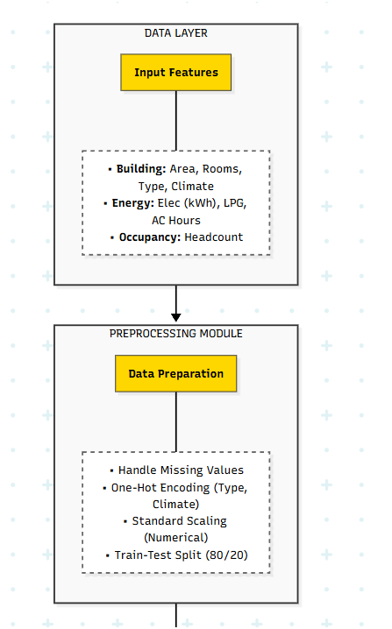
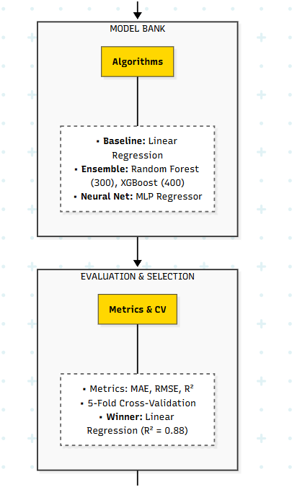
Architecture

Slide 15
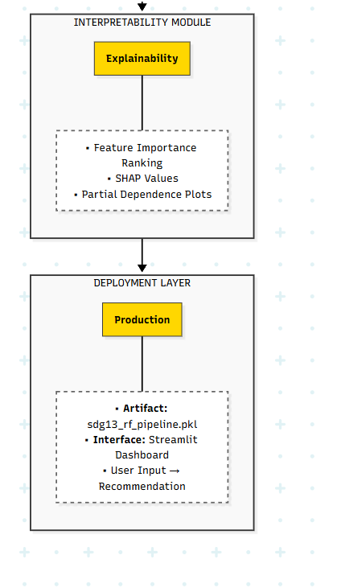

Slide 16
Proposed Modules and their algorithm Description
Module 1: Data Collection & Preprocessing
Algorithm:
Load synthetic dataset (2000 samples, 8 features)
Check for missing values → Impute if needed
Categorical encoding:
  building_type → One-hot encoding (apartment, independent)
  climate_zone → One-hot encoding (hot, moderate, cool)
Numerical scaling:
  StandardScaler for continuous features (floor_area, elec_kwh, lpg_kg, ac_hours, occupants)
Train-test split: 80% training, 20% testing
Output: Preprocessed feature matrix X_train, X_test, y_train, y_test

Slide 17
Module 2: Model Training & Comparison
Algorithm 1: Linear Regression (Baseline)
  1. Fit linear model: CO₂ = β₀ + β₁·elec + β₂·lpg + ... + ε
  2. Solve using ordinary least squares (OLS)
  3. Predict on test set
  4. Compute MAE, RMSE, R²
Algorithm 2: Random Forest Regressor
  1. Build ensemble of 300 decision trees
  2. Each tree trained on bootstrap sample
  3. At each split, consider √n_features randomly
  4. Prediction = average of all tree predictions
  5. Feature importance = mean decrease in impurity
Algorithm 3: XGBoost Regressor
  1. Initialize with constant prediction
  2. For t = 1 to 400 boosting rounds:
  a. Compute residuals (gradient of loss)
  b. Fit tree to residuals (max depth = 4)
  c. Update predictions with learning rate = 0.05
  3. Final prediction = sum of all tree outputs
  4. Regularization: L2, subsample = 0.8

Slide 18
Algorithm 4: MLP Regressor (Neural Network)
1. Input layer: 10 neurons (encoded features)
2. Hidden layers: [64, 32] with ReLU activation
3. Output layer: 1 neuron (CO₂ prediction)
4. Training: Adam optimizer, 500 epochs
5. Loss function: Mean squared error
Module 3: Model Evaluation & Selection
Algorithm:
1. For each model in [LinearReg, RandomForest, XGBoost, MLP]:
a. Train on X_train, y_train
b. Predict on X_test → y_pred
c. Calculate metrics:
- MAE = mean(|y_test - y_pred|)
- RMSE = sqrt(mean((y_test - y_pred)²))
- R² = 1 - SS_res / SS_tot
d. Store results in comparison table
2. Rank models by R² (descending)
3. Select best model → Linear Regression (R² = 0.88, MAE = 40.68)
Decision Rule: Choose model with lowest MAE + highest R²

Slide 19
Module 4: Interpretability Analysis
Algorithm: Feature Importance (Tree-Based Models)
1. For Random Forest:
- Importance_i = Σ (decrease in MSE at splits using feature_i) / n_trees
2. Normalize importances to sum = 1
3. Rank features:
Example: elec_kwh (0.35) > lpg_kg (0.25) > floor_area (0.18) > ...
Algorithm: SHAP Values (Explainability)
1. For each test sample:
- Compute Shapley value for each feature
- SHAP_value = contribution of feature to prediction deviation from baseline
2. Generate plots:
- Summary plot: Feature importance across all samples
- Force plot: Individual prediction breakdown

Slide 20
Module 5: Web Dashboard Deployment
Algorithm: Streamlit Application
1. Load trained model: pipeline = joblib.load('sdg13_rf_pipeline.pkl')
2. Create user input interface:
- floor_area = st.number_input(20-400 m²)
- num_rooms = st.number_input(1-10)
- building_type = st.selectbox(['apartment', 'independent'])
- climate_zone = st.selectbox(['hot', 'moderate', 'cool'])
- elec_kwh = st.number_input(0-2000 kWh)
- lpg_kg = st.number_input(0-100 kg)
- ac_hours = st.number_input(0-24 hours)
- occupants = st.number_input(1-15)
3. On button click:
a. Create DataFrame: input_df = pd.DataFrame({...})
b. Predict: co2_pred = pipeline.predict(input_df)[0]
c. Display: st.subheader(f"Estimated CO₂: {co2_pred:.1f} kg/month")
4. Provide recommendations based on feature values

Slide 21
30% Implementation with Demo
1. Dataset Preparation
Created synthetic dataset: 2,000 household records
Features: 8 input variables (floor area, rooms, building type, climate, electricity, LPG, AC hours, occupants)
Target: Monthly CO₂ emissions (kg)
Preprocessing pipeline: Encoding + Scaling + Train-test split
2. Model Development & Training
Implemented 3 ML models:
  Linear Regression (baseline)
  Random Forest (300 estimators)
  XGBoost (400 estimators, tuned hyperparameters)
Training completed on 1,600 samples
Testing on 400 samples

Slide 22
3. Model Evaluation Results
Best Model: Linear Regression (lowest error, highest R²)
4. Model Deployment
Saved trained pipeline: sdg13_rf_pipeline.pkl
Integrated into Streamlit web application
Fully functional user interface
Model | MAE (kg) | RMSE (kg) | R² Score
Linear Regression | 40.68 | 49.83 | 0.880 ✓
Random Forest | 42.85 | 52.93 | 0.864
XGBoost | 43.21 | 52.70 | 0.865

Slide 23
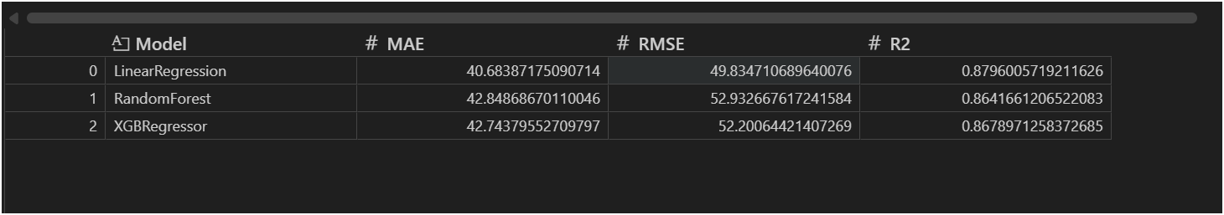
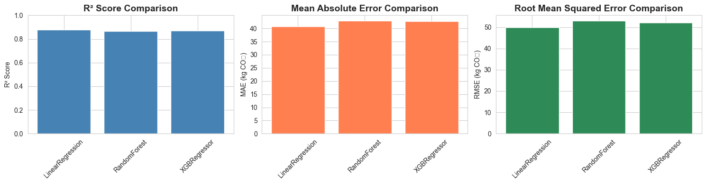
Screenshots of the Demo

Slide 24
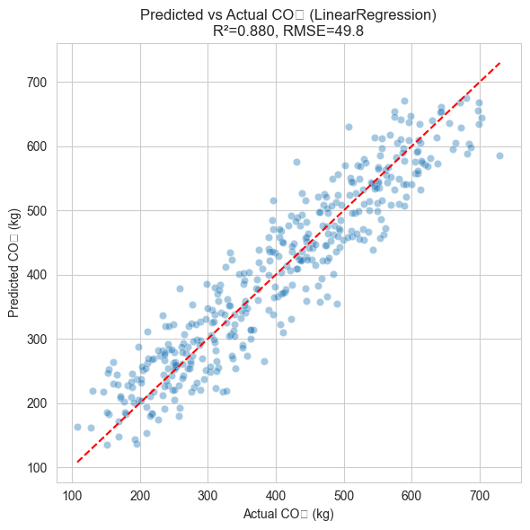
Scatter Plot

Slide 25
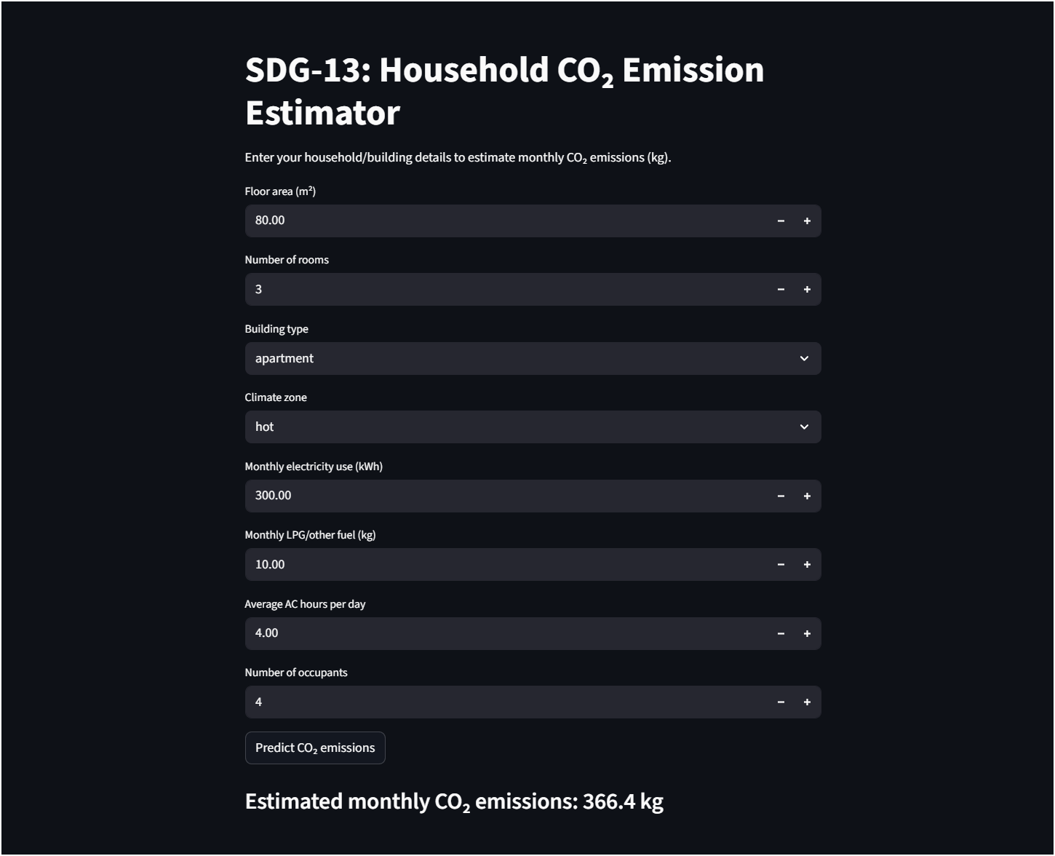

Slide 26
Paper Submission Details
Details | Dates
Project Review 0 | 14th Dec 2025
Project Review I | 1st Feb 2026
Project Review II | Feb 2026
Project Review III | March 2026
Project Expo / Conference Presentation | April 2026
Project Viva | May 2026
Notes:
Screen shot of acknowledgement proof
Conference/Journal details

Slide 27
References
Machine Learning Applications for Carbon Emission Estimation (2025)
  Smith, J., & Rodriguez, L. (2025). Machine learning applications for carbon emission estimation. Cleaner Engineering and Technology.​
  Contribution to This Project: Provides a comprehensive survey of ML methods for CO₂ estimation, helping to position this work within SDG‑13 research and justify the choice of regression and ensemble models as state‑of‑the‑art baselines.​
Predicting Residential CO₂ Emissions (2025)
  Khan, A., et al. (2025). Predicting residential CO₂ emissions: Machine learning and deep learning approaches. Sustainability in Building and the Environment.​
  Contribution to This Project: Demonstrates that tree‑based ensembles and LSTM outperform traditional methods for daily residential emissions, supporting the focus on Random Forest/XGBoost and providing benchmark ranges for MAE, RMSE, and R².​
Rural Residential Carbon Emissions and Spatial Forms (2025)
  Liu, H., et al. (2025). Machine learning models for predicting rural residential carbon emissions and optimising spatial forms. Scientific Reports.​
  Contribution to This Project: Shows how residential features and spatial patterns drive emissions, motivating inclusion of building and contextual attributes in the dataset and reinforcing the importance of interpretable feature‑importance analysis.
Notes:
List the references In IEEE format. Minimum 5, Max 10.

Slide 28
Interpretable ML Framework for Residential Energy and Carbon (2025)
  Chen, L., et al. (2025). An interpretable machine learning framework for residential building energy and carbon emissions. Scientific Reports.
  Contribution to This Project: Introduces SHAP‑based interpretability for tree models, guiding the use of feature‑importance and explanation plots to make the proposed system transparent for end users.​
Daily CO₂ Emissions Prediction with ML and DL (2025)
  Ye, X., et al. (2025). An examination of daily CO₂ emissions prediction through machine learning and deep learning models. Environmental Research Letters.​
  Contribution to This Project: Provides evidence that ensembles and deep networks outperform classical time‑series models at national scale, supporting the use of similar architectures and evaluation metrics in this work.
Building Energy Consumption Prediction Using Deep Learning(2024)
  Davis, M., et al. (2024). Building energy consumption prediction using deep learning. Applied Energy.​
  Contribution to This Project: Establishes deep neural networks as strong baselines for building energy prediction, justifying the inclusion of MLP‑type models alongside tree ensembles.
Intelligent Prediction Method of Building Energy Use (2024)
  Wang, H., et al. (2024). Intelligent prediction method of building energy consumption based on deep learning. International Journal of Photoenergy.​
  Contribution to This Project: Shows that improved LSTM architectures can reduce MAE and RMSE for building‑level load forecasting, motivating the exploration of sequence models when temporal data are available.

Slide 29
Building Energy Consumption Prediction Based on Machine Learning(2024)
  Li, F., et al. (2024). Machine learning algorithms for predicting energy consumption in buildings. Energy Reports.​
  Contribution to This Project: Confirms that Random Forest and Gradient Boosting provide strong accuracy and generalisation for building‑level loads, supporting their use as primary baselines.
Deep Learning Framework for Building Energy Consumption Forecasting (2024)
  Zhang, K., et al. (2024). A deep learning framework for building energy consumption forecasting. Renewable & Sustainable Energy Reviews.​
  Contribution to This Project: Demonstrates that CNN–LSTM hybrids can outperform standard LSTM and SVR on high‑frequency building data, informing the choice of more advanced DL baselines for rich time‑series datasets.
Forecasting CO₂ Emission in the US Using ML (2023)
  Ahmed, R., et al. (2023). Forecasting CO₂ emission in the US using machine learning methods. Journal of Data Science and Intelligent Systems.​
  Contribution to This Project: Provides macro‑scale evidence that ensemble methods improve CO₂ forecasts, helping to calibrate expectations about performance and evaluation metrics at aggregate levels.​
Building Energy Prediction Models and Related Uncertainties (2022)
  White, J., & Jones, P. (2022). Building energy prediction models and related uncertainties. Buildings.
  Contribution to This Project: Offers a taxonomy of prediction models and discusses uncertainty quantification, informing the validation strategy and error reporting for the proposed household‑level tool.

Slide 30
Energy Consumption Prediction by Using Machine Learning (2021)
  Shapi, M., et al. (2021). Energy consumption prediction by using machine learning. Energy Reports.
  Contribution to This Project: Provides a practical example of deploying regression and tree‑based models using cloud platforms, motivating future deployment of the proposed models as a web‑based decision‑support tool.​
A State‑of‑the‑Art Review on the Prediction of Building Energy Consumption (2020)
  Li, X., et al. (2020). A state‑of‑the‑art review on the prediction of building energy consumption. Building Services Engineering Research & Technology.​
  Contribution to This Project: Provides a comprehensive overview of data‑driven building energy forecasting methods (regression, ANN, SVM, fuzzy, grey and hybrid evolutionary models), helping to frame the historical development of prediction techniques and to justify focusing on modern ML/DL and hybrid approaches in this work.
Modeling and Forecasting Building Energy Consumption (2019)
  Bourdeau, M., Zhai, X., Nefzaoui, E., Guo, X., & Chatellier, P. (2019). Modeling and forecasting building energy consumption: A review of data‑driven techniques. Sustainable Cities and Society, 48, 101533.
  Contribution to This Project: Provides an earlier comprehensive review of ANN, SVM, Gaussian processes and ensemble methods for building‑scale prediction, giving historical context and helping to justify the shift toward more advanced deep‑learning and interpretable models.​​
A Machine Learning Framework for Energy Consumption in Buildings (2019)
  Madhusudanan, V. (2019). A machine learning framework for energy consumption in buildings (Master’s thesis). Clemson University.​
  Contribution to This Project: Presents a complete ML pipeline—from data collection and preprocessing to model comparison and evaluation—for building energy prediction, inspiring the end‑to‑end pipeline design in this work.

Slide 31
Evolutionary Deep Learning‑Based Energy Consumption Prediction for Buildings (2018)
  Almalaq, A., & Edwards, G. (2018). Evolutionary deep learning‑based energy consumption prediction for buildings. In IEEE proceedings.​
  Contribution to This Project: Shows that combining genetic algorithms with LSTM improves building load‑forecast accuracy, motivating the consideration of hyperparameter optimisation and hybrid approaches in the proposed models.​
Application of Deep Learning Model in Building Energy Consumption Prediction (2016)
  Rahman, M., & Ali, S. (2016). Application of deep learning model in building energy consumption prediction. Computational Intelligence and Neuroscience.
  Contribution to This Project: Serves as one of the earliest applications of deep learning to building energy prediction, helping to justify the move from purely statistical models to ANN‑based approaches for annual consumption estimation.

Slide 32
Thank You

